Slide 1
IncludNet: discover your own potential
Training program

Slide 2
The training
The present training program has been co-designed by professional experts within the EU project IncludNet. Its main educational objective is to foster self-determination, self-consciousness and self-entrepreneurship.
Notes:
The training program has been designed for people with intellectual disability. Training processes and tools has been adapted for people with ID, i.e. they are easy-to-understand, simplified and easy-to-read.

Slide 3
Training modules
Discover your own potential
1
Context analysis
2
Project feasibility
3
What do I start with?
4

Slide 4
Module 3
Project feasibility

Slide 5
Project feasibility: the business model canvas
Marta Milian – Ampans

Slide 6
Ice breaker
Let’s get to know each other!
Notes:
Ice breaker > include an ice-breaking activity for participants (according to your preferences).

Slide 8
Having identified ideas and potential projects

Slide 9
How to begin to develop a plan?

Slide 10
How do you analyse the feasibility of a project?
What is the gap between reality and desire?

Slide 11
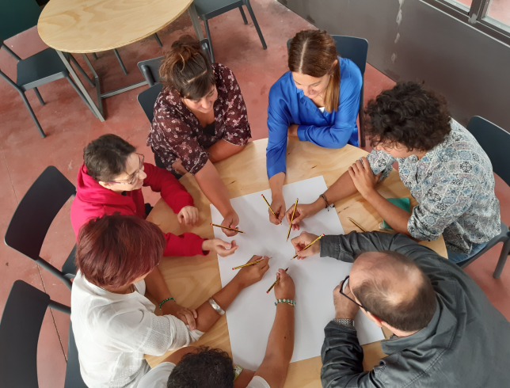
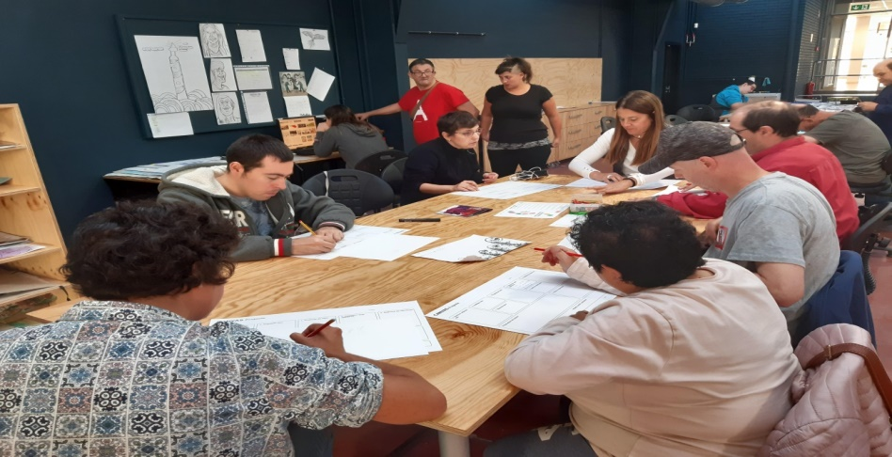
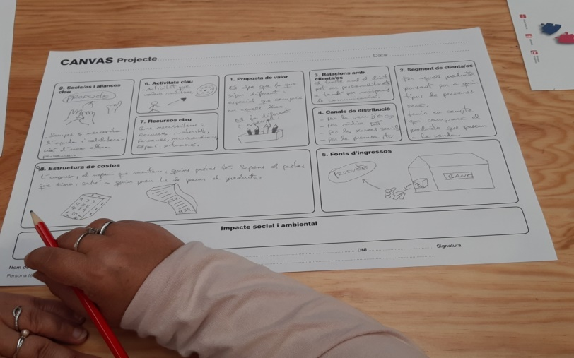
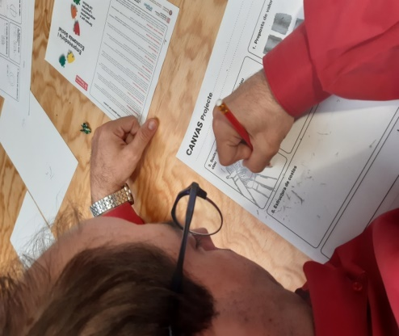
Co-Production activities

Slide 12
Activities
Co-productive activities through focus-group:
1. Define Feasibility (with easy reading and images / symbols)
2. Workshop to visualize how we get from desire / illusion to reality (Canvas)

Slide 13
What is feasibility?
Feasibility is understood as ...
Possibility of a successful project
You need to evaluate the viability of a project before you start, to make sure it works

Slide 14
Feasibility is like a gear
In a project, every single part depends on the others to achieve a good result.

Slide 15
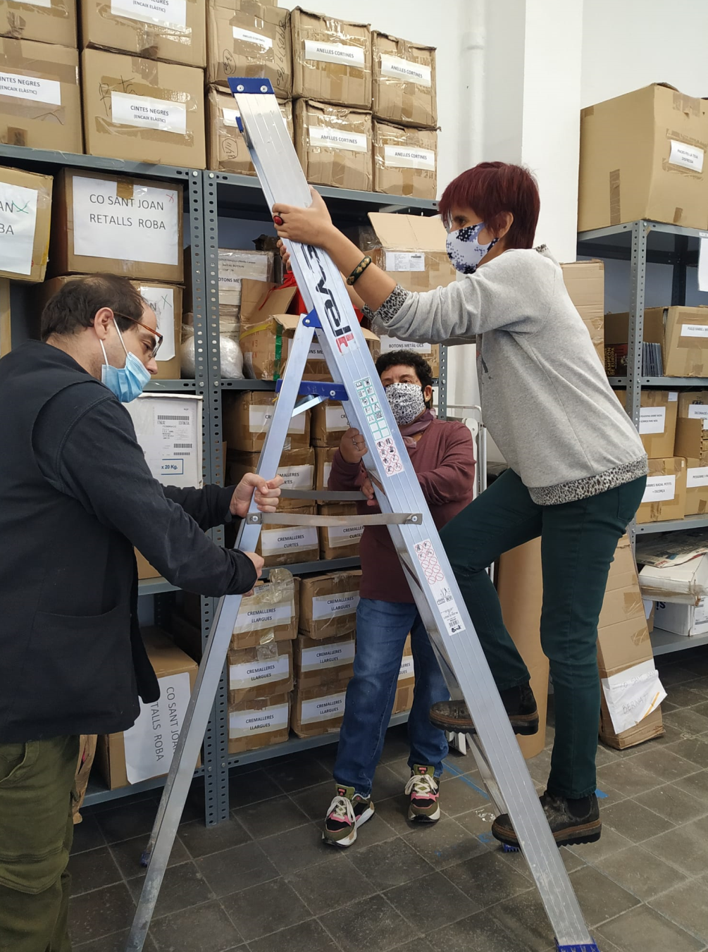
Collaboration enhances feasibility
Having good colleagues and partners help along the project.

Slide 16
Feasibility is to find the appropiate tools
To develop a project it is necessary to identify and use the most convenient tools.

Slide 17
Feasibility is to control resources
To develop a project, there must be an identification of the resources needed and how to get them.

Slide 18
Measuring enhances feasibility
Being aware of the environment before starting the project.

Slide 19
The tool
From our point of view, an important tool is the Business Model Canvas (BSM)
Notes:
The Business Model Canvas (BMC) is a user-friendly strategic management start-up template for developing new or documenting existing business models.
It is a visual chart composed of different blocks describing a firm's or product's value proposition, infrastructure, customers, and finances.
It helps you understand a business model in a straightforward, structured way, also illustrating potential trade-offs
https://www.youtube.com/watch?v=QoAOzMTLP5s

Slide 20
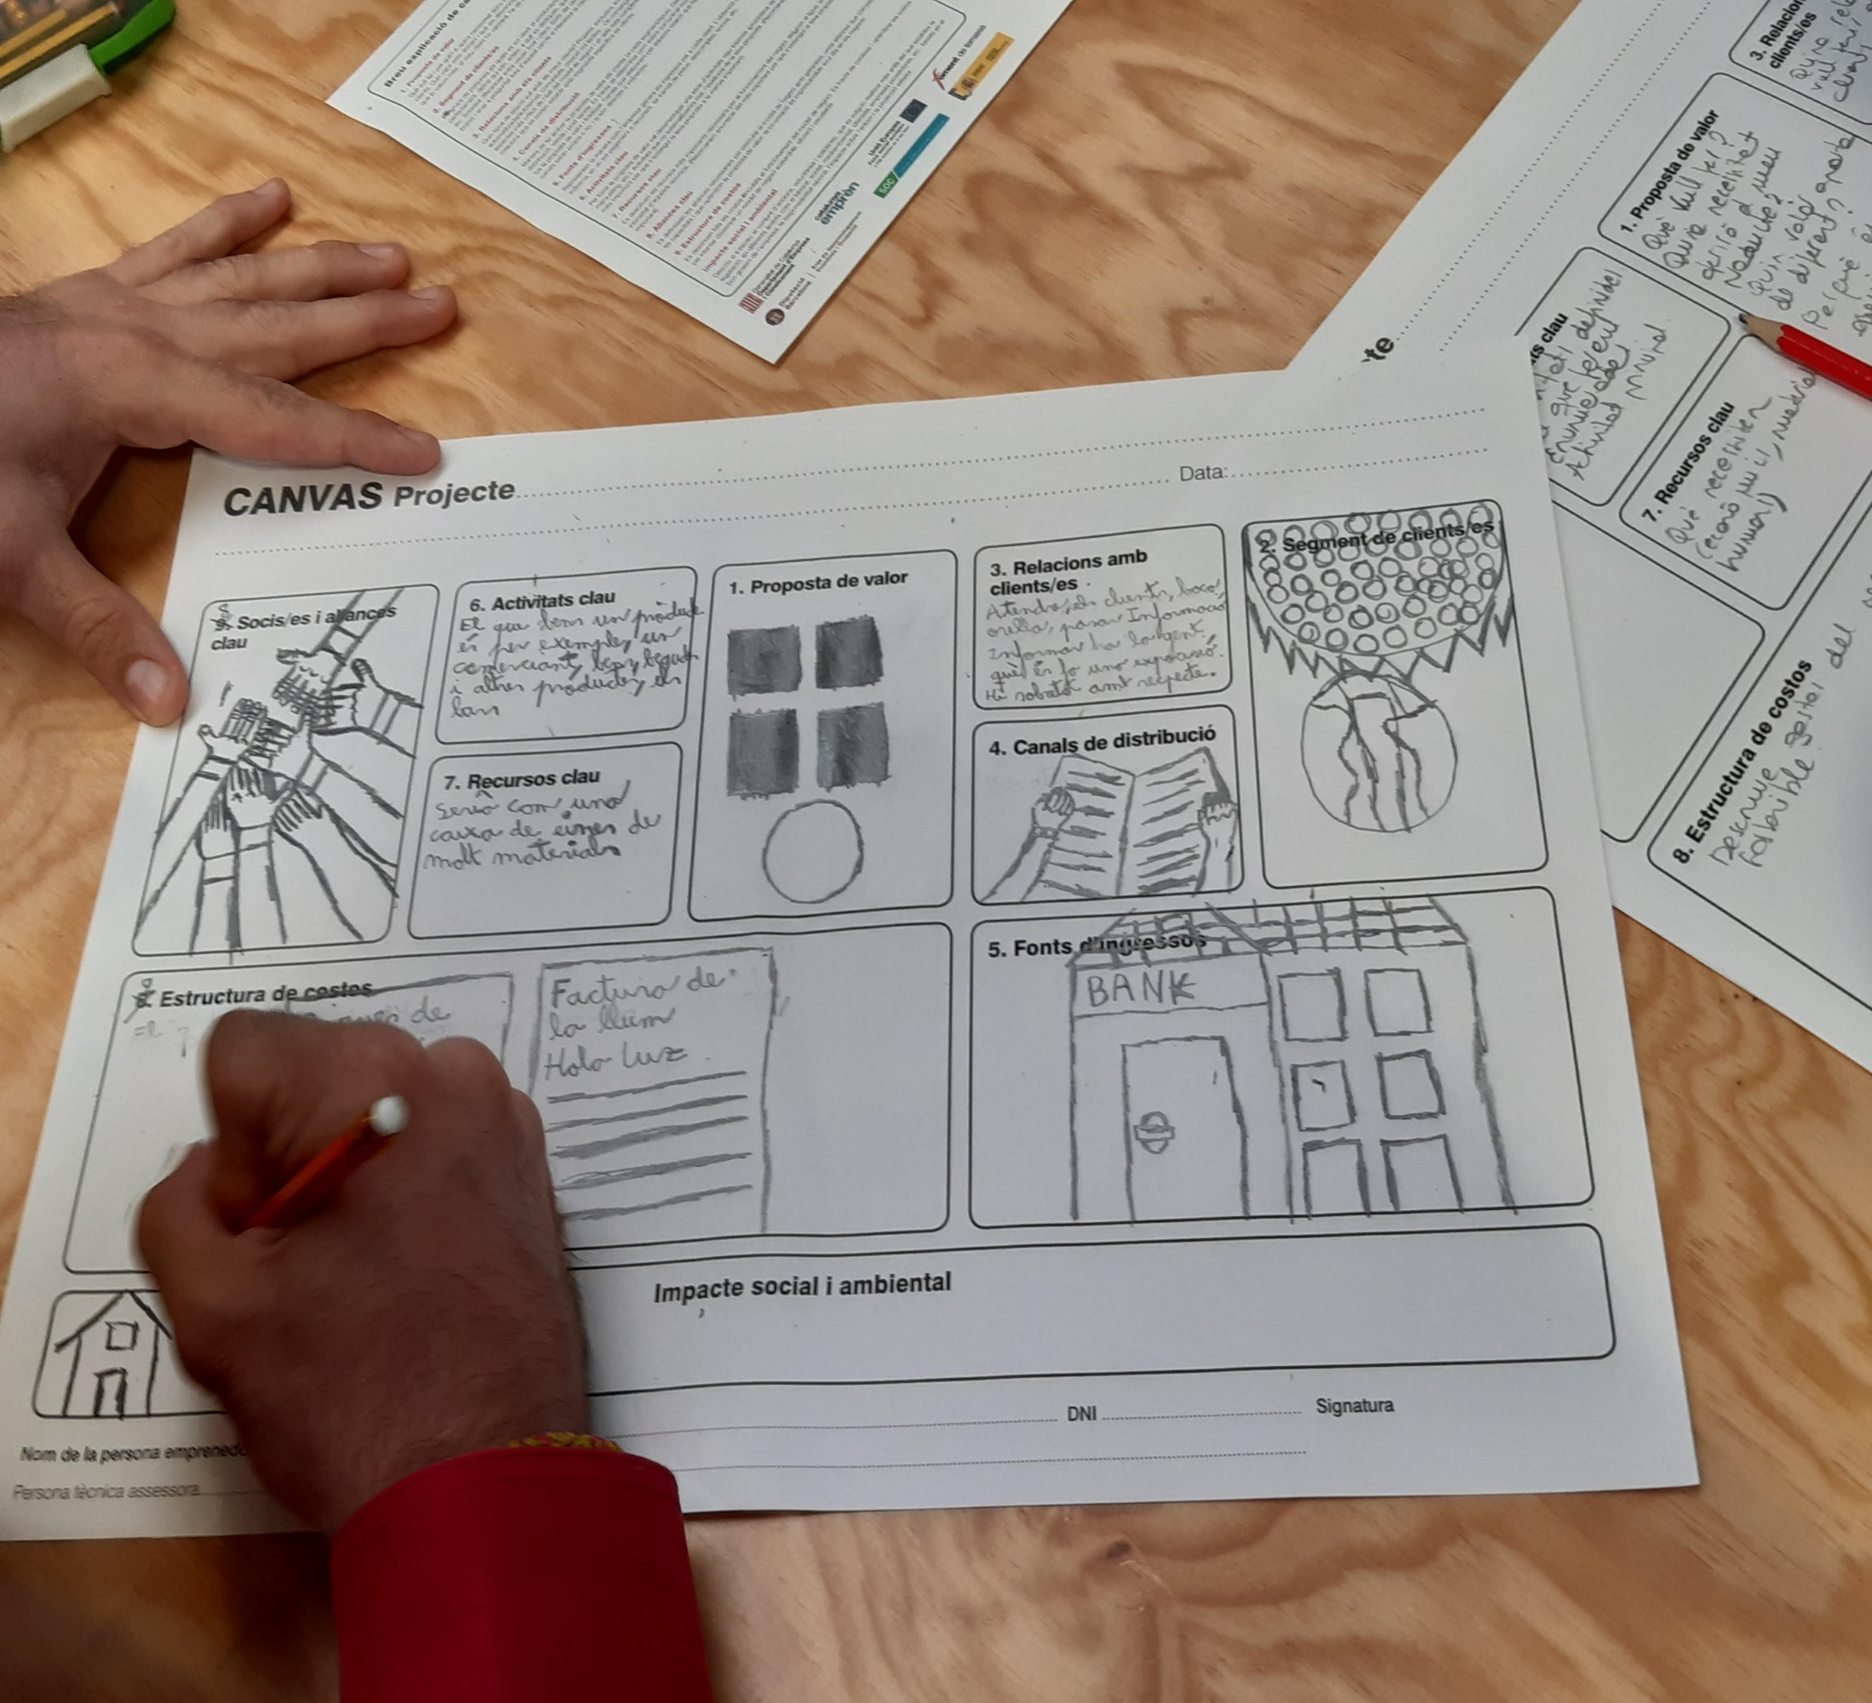
Business Social
CANVAS Model
Notes:
Based on this one, what have we done?
Adapt it to easy reading
in a process of co-production
with the people in our entrepreneurship project
These users have previously been trained in easy reading and co-production.
For the Adaptation process:
Read and evaluate the understanding of the model with people
Validate changes with people
Design a graphic reference that symbolizes the text together
Make a pilot with a business idea as an example

Slide 21
Want to know what CANVAS is?
https://www.youtube.com/watch?v=QoAOzMTLP5s

Slide 22
Notes:
In the focus group I have been making a co creative Social CANVAS Model :
Describe the conceptes of the model
Drawing the conceptes
And exemples
The result is a Model in a Easy read

Slide 23
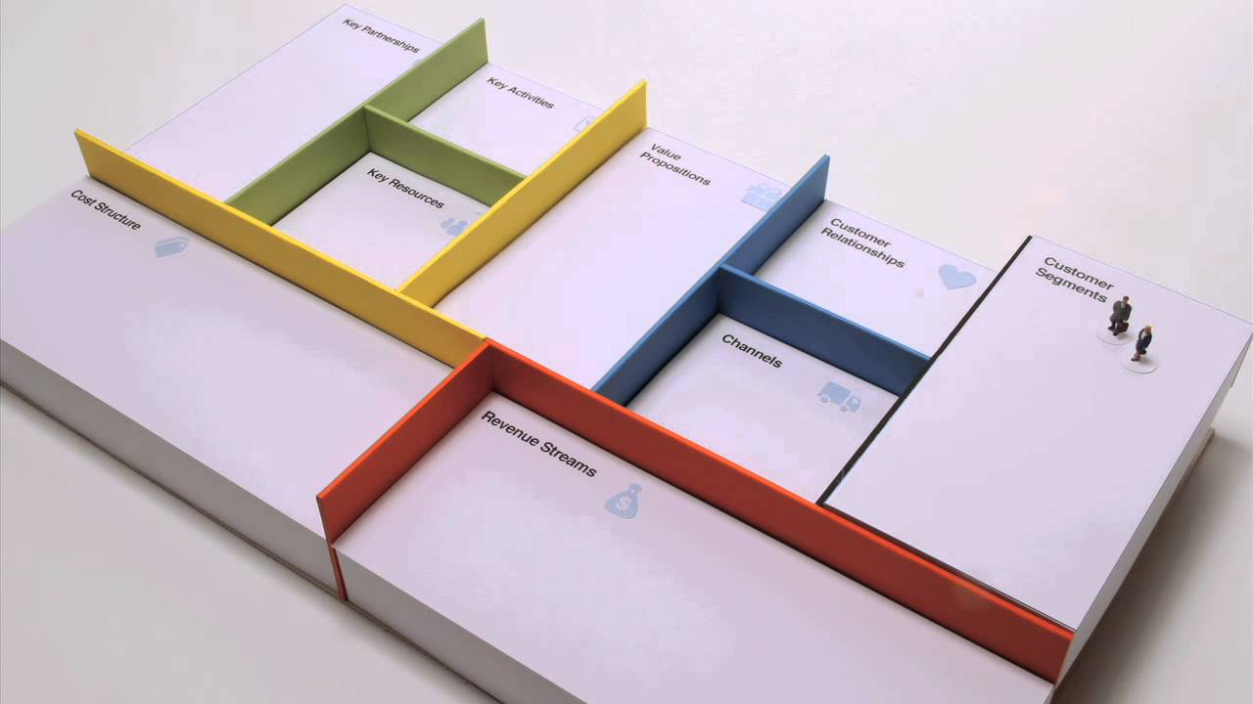
Canvas blocks
Proposal (product/service)
Client segment
Relations with clients
Distribution channels
Sources of income
Key activities
Key resources
Key alliances
Cost structure
Social and environmental impact
Notes:
With an example: Build a residence for people with disabilities and their families

Slide 34
Exercise
We will understand how to design a successful business model through the Canvas Business Model methodology Work on a team
Choose an idea, from which you build a Canvas by answering the following questions:
Who is our audience?
This section explains which group of people the product or service will be offered to. The more knowledge you have of this group of people, the better.
Who can help us? It is a matter of identifying the people or companies we will collaborate with and who can add more value to the service we offer.
What do we need cover? It is also called a value proposition and is a way of explaining our service, but with an emphasis on the need or problem we are solving.

Slide 35
Exercise
What activities do we offer to solve needs or problems?
What resources do we need to be able to offer these activities?
They can be human, material or economic resources. What will we get?
They can be income in the case of a company or the impact of our action if it is a social project.
What will it cost us to develop the project? Both, money and time.
How will we communicate?
How will we reach our customers or users?
What will we do to keep customers with us? Actions for customers to stay and buy or use our services again

Slide 36
Entrepreneurship is possible! Take a look at these entrepreneurial experiences
Business Booming, Entrepreneur With Down Syndrome Now Hiring Employees With Disabilities – YouTube
Steve Jobs Motivational Speech | Inspirational Video | Entrepreneur Motivation | Startup Stories – YouTube

Slide 37
If you have a pound dream, achieve it!
https://www.youtube.com/watch?v=sdUUx5FdySs

Slide 38
Thank you
Partners:
CADIAI
ARFIE
EEA Margarita
Amadip-Esment Fundació
Fundació Ampans
CECD – Cooperativa para a Inclusão

